Slide 1

E-commerce Product Delivery Prediction

Slide 2

AGENDA
Introduction and Objectives
Business Need and Impact
Data Exploration and Feature
Modelling Approach
Model Performance and Evaluation
Results and Visualizations
Technical Implementation
Conclusion and Future Work
Q&A

Slide 3

INTRODUCTION
In the fast-growing world of e-commerce, timely product delivery plays a crucial role in customer satisfaction and business success.
This project leverages machine learning to predict whether a product will be delivered on time, helping companies optimize logistics, improve operational efficiency, and enhance the overall customer experience. By analyzing key factors affecting delivery performance, our models aim to provide actionable insights for better decision-making.

Slide 4

PROBLEM STATEMENT
In the fast-paced world of e-commerce, timely product delivery is crucial for customer satisfaction and operational efficiency. However, various factors such as shipping distance, warehouse processing time, product characteristics, and logistics constraints impact delivery timeliness.
This project aims to develop machine learning models to predict whether an e-commerce order will be delivered on time. By analyzing historical delivery data, the model will identify key factors affecting delivery performance, enabling the company to optimize logistics, improve customer communication, and enhance overall service quality. The insights gained will help the company implement proactive measures to mitigate delays and set realistic delivery expectations for customers.
Notes:
E-commerce Customer Segmentation and Prediction
Develop a robust customer segmentation model and a predictive classifier to categorize customers based on their purchasing patterns. This will enable the company to tailor marketing strategies, improve customer retention, and optimize inventory management.

Slide 5

OBJECTIVE OF THIS PROJECT
The primary objective of this study is to develop robust machine learning models to accurately predict whether an e-commerce product will be delivered on time. By leveraging data-driven insights
The study aims to:
Identify key factors affecting delivery performance.
Enhance customer satisfaction by setting accurate delivery expectations.
Compare multiple machine learning models to determine the most effective approach for prediction.

Slide 6
Value of the Study
Business Efficiency 🚚 – Helps companies optimize logistics and reduce delays, leading to cost savings.
Customer Satisfaction ⭐ – Accurate delivery predictions enable businesses to set realistic expectations, reducing complaints and increasing trust.
Data-Driven Decision Making 📊 – Provides insights into the most influential factors affecting on-time delivery, allowing companies to make informed improvements.
Competitive Advantage 📦 – E-commerce platforms can use these predictions to offer better delivery guarantees, improving customer retention.
Scalability – The predictive model can be extended to different regions, shipping carriers, and product categories for broader applications.

Slide 7
Work Flow
Data Collection & Preprocessing
Exploratory Data Analysis (EDA)
Feature Engineering
Model Selection & Training
Deployment
Performance Evaluation
Conclusion
Results

Slide 8

DATA AND METHOLOGY

Slide 9
DATA SUMMARY
General Information
Number of Rows: 10,999
Integer: 8 columns
Object (Categorical): 4 columns
Number of Columns: 12

Slide 10
DATA SUMMARY Continued……
Sl. No. | Feature Name | Description
1 | ID | identifier for each order.
2 | Warehouse_block | Warehouse location from where the product is shipped (A, B, C, D, F).
3 | Mode_of_Shipment | Type of shipping method (Ship, Flight, Road, etc.).
4 | Customer_care_calls | Number of calls made by the customer regarding the order.
5 | Customer_rating | Rating given by the customer (1 to 5)
6 | Cost_of_the_Product | Price of the purchased product.
7 | Prior_purchases | Number of prior purchases made by the customer.
8 | Product_importance | Importance level of the product (low, medium, high).
9 | Gender | Gender of the customer (Male/Female).
10 | Discount_offered | Discount percentage applied to the product.
11 | Weight_in_gms | Weight of the product in grams.
12 | Reached.on.Time_Y.N | Target variable (1 = Delivered on time, 0 = Delayed)

Slide 11
DATA CLEANING AND PREPROCESSING TECHNIQUES
Handlle Missing Values and remove duplicate entries
There are no missing values and ID may not provide useful insights.
Identifying Categorical Columns
Warehouse_block (Categories: A, B, C, D, F)
Encoding Categorical Data
Product_Importance (Low < Medium < High) as:
Low → 0 Medium → 1 High → 2
Mode_of_Shipment (Ship, Flight, Road) → Converted into Mode_Ship, Mode_Flight, Mode_Road (0 or 1).
Identifying Target Column
Mode_of_Shipment (Categories: Ship, Flight, Road, etc.)
Product_Importance (Categories: Low, Medium, High)
Gender (Categories: Male, Female)
"Reached_on_Time_Y.N“ is the target variable and 0 for “ ON TIME” and 1 for “DELAYED”

Slide 12


Slide 13
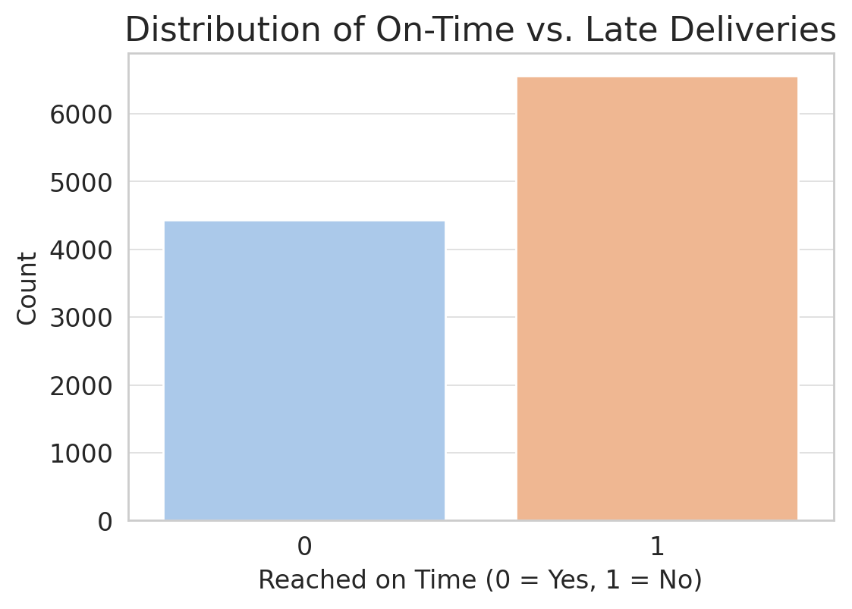
The number of late deliveries (1) is higher than the number of on-time deliveries (0).
59.67% of deliveries were late (1), while 40.33% were on time (0).
There is moderate class imbalance, but it's not extreme.

Slide 14
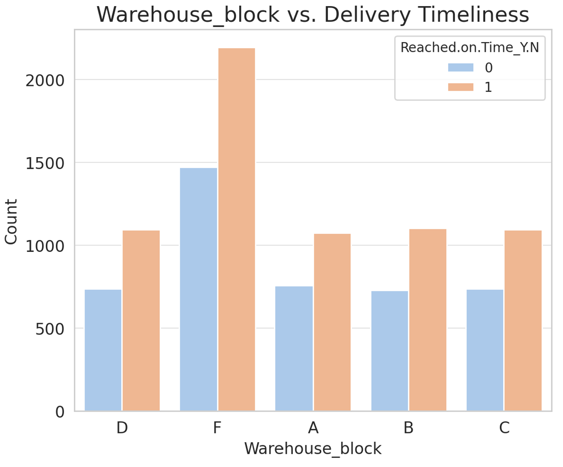
Some warehouses (e.g., Block F) have higher late deliveries.
Logistic inefficiencies in certain warehouses may impact timeliness.

Slide 15
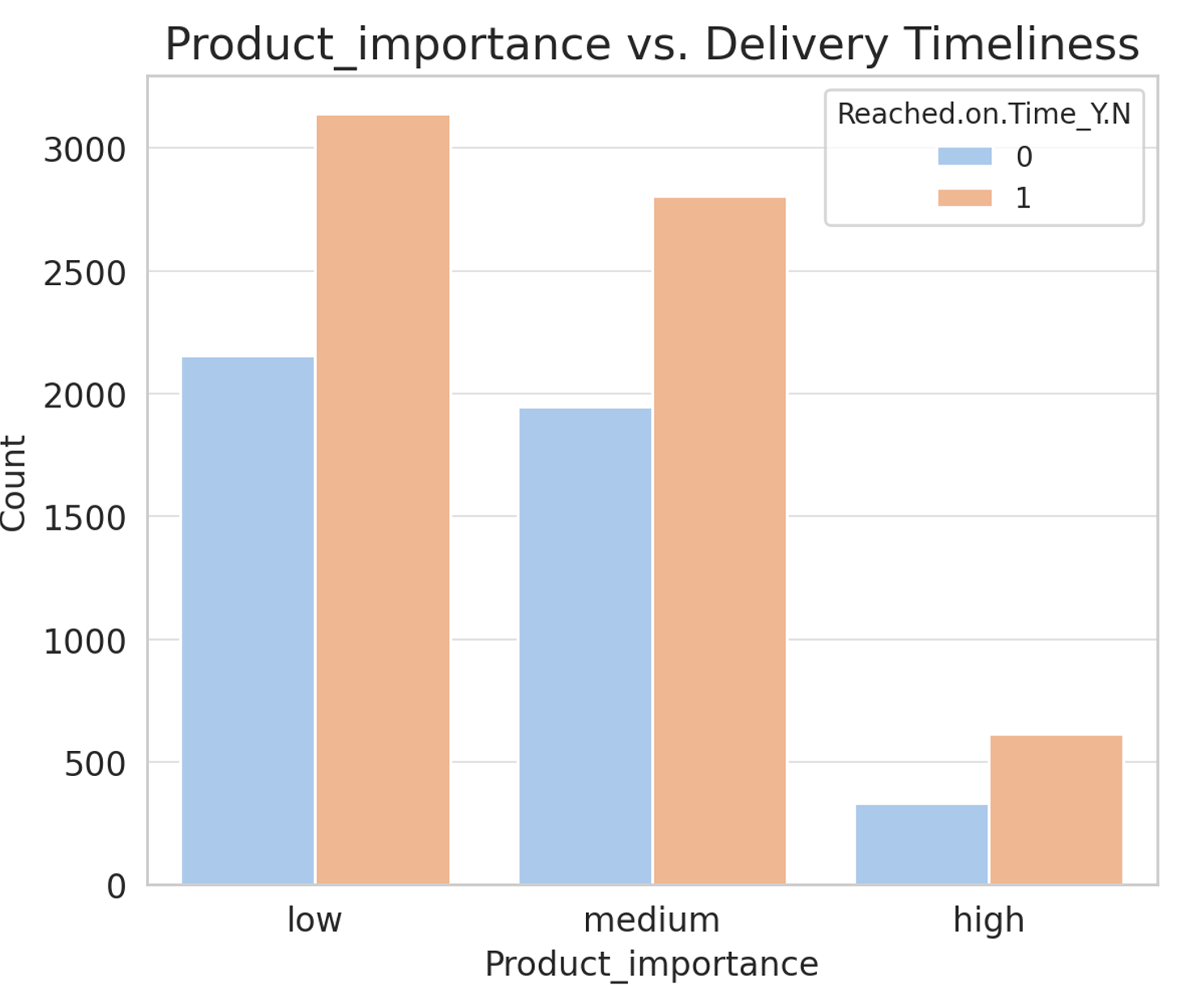
High-importance products have slightly fewer late deliveries.
Low and Medium importance products face more delays, possibly due to prioritization

Slide 16
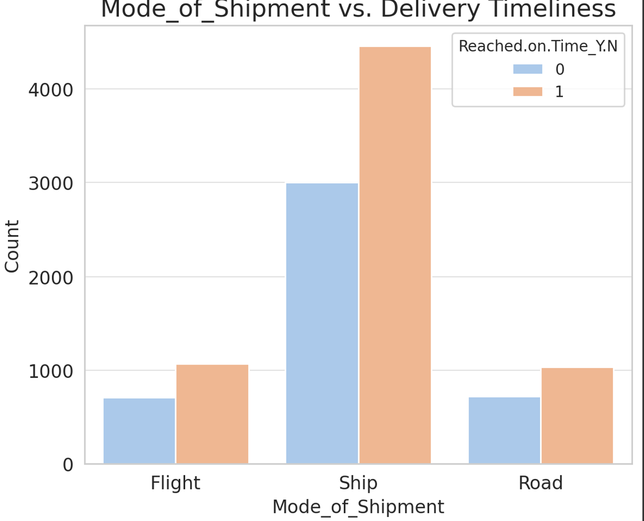
Shipments by Ship have significantly more late deliveries than Flight or Road.
Flight appears to be the fastest mode, with fewer delays.

Slide 17
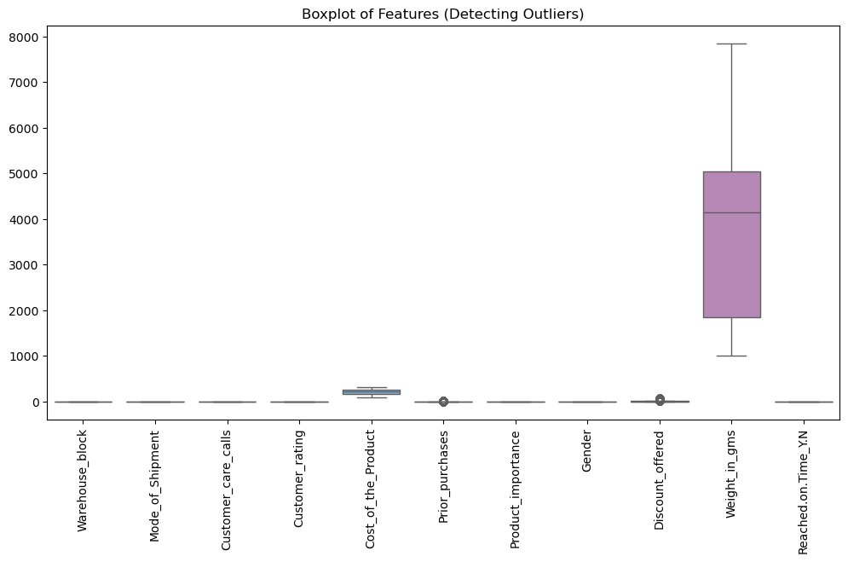
The "Weight_in_gms" feature has significantly larger values compared to other features.
The large scale difference makes it difficult to observe outliers in smaller-value features.
"Cost_of_the_Product" and "Discount_offered" show some outliers, represented by individual points outside the whiskers.
"Discount_offered" has a few extreme values.
Other features have relatively compact distributions with no extreme outliers.
"Weight_in_gms" has a wide interquartile range (IQR), indicating high variability.
Most other features have relatively small variability and are centered around their medians.

Slide 18
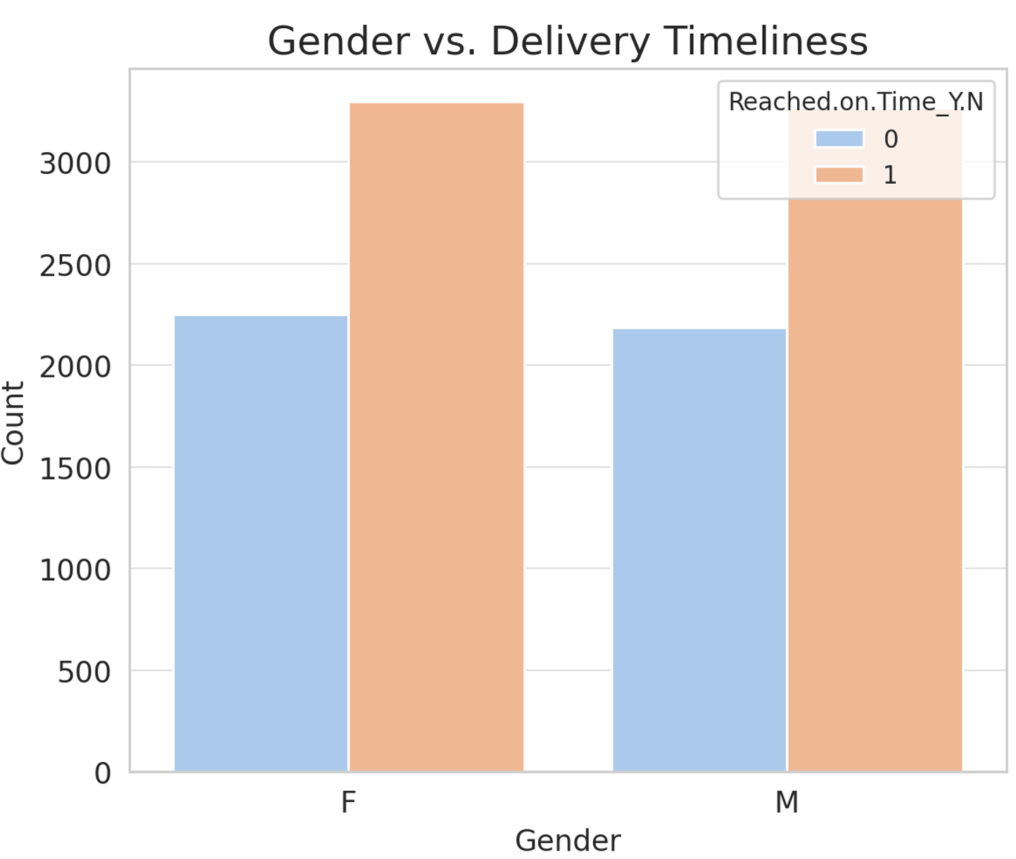
No significant impact on delivery timeliness

Slide 19
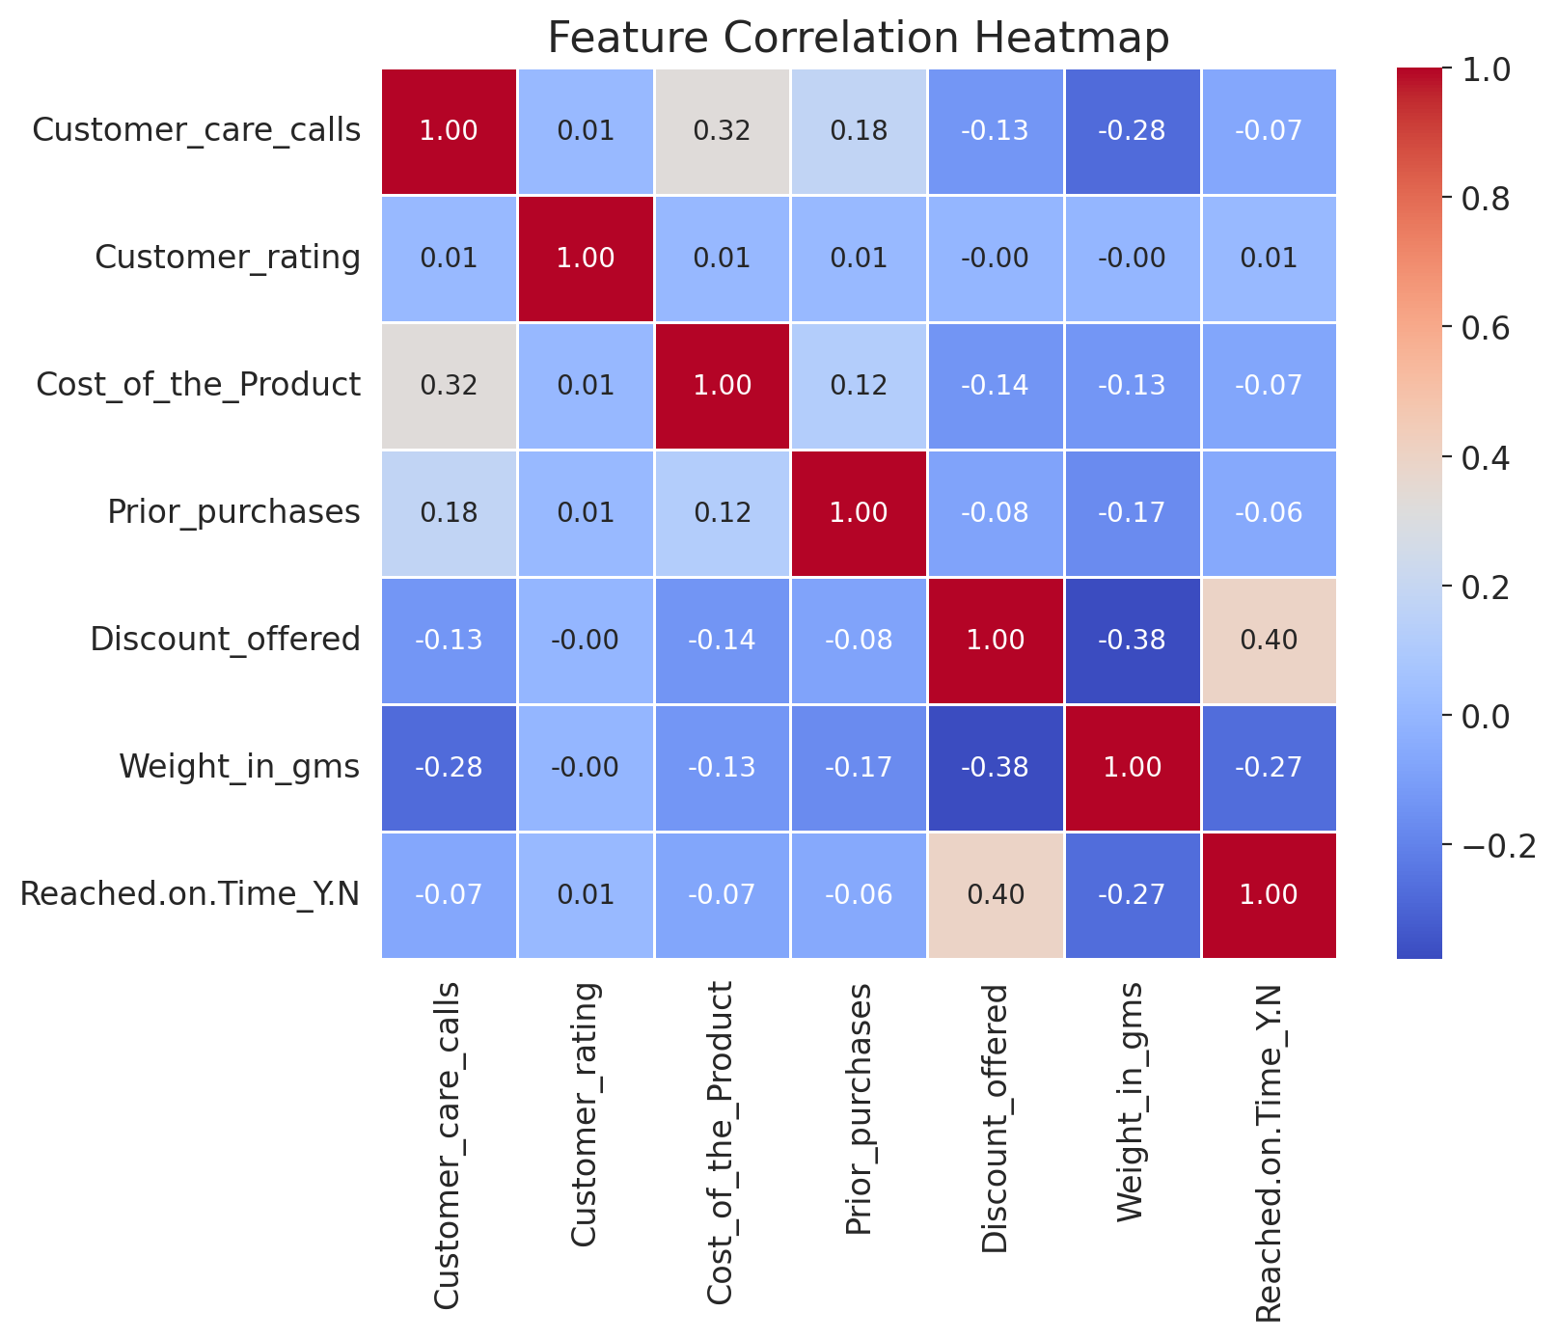
1 indicates a strong positive correlation (red)
0 indicates no correlation (neutral, white/gray)
-1 indicates a strong negative correlation (blue)

Slide 20
Feature correlation heat map continues
Self-Correlations (Diagonal Elements)
Each feature has a correlation of 1.00 with itself, which is expected.
Significant Correlations
Discount Offered & Reached on Time (0.40) → Higher discounts are associated with delayed deliveries.
Cost of the Product & Customer Care Calls (0.32) → More expensive products tend to generate more customer care calls.
Negative Correlations
Weight in grams & Discount Offered (-0.38) → Heavier products receive lower discounts.
Weight in grams & Reached on Time (-0.27) → Heavier products are more likely to be delayed in delivery.
Customer Care Calls & Weight (-0.28) → Heavier products generate fewer customer care calls.
Weak or No Correlations
Customer Rating has almost no correlation with other features, implying that ratings are not influenced significantly by cost, discount, or delivery time.

Slide 21
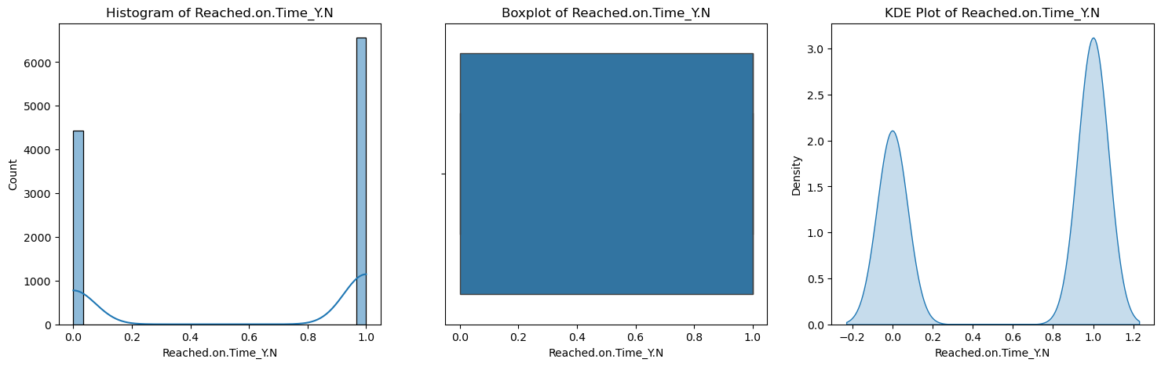
Two distinct peaks
Peak near 0.0: High count of observations with low values (deliveries not on time).
Peak near 1.0: High count of observations with high values (deliveries on time).
Valley in the middle (~0.5): Few observations fall in the intermediate range,a binary-like behavior most outcomes are either fully on-time or fully late
Median: Likely around 0.5 (middle of the range)
IQR (Box): Spans a wide range (e.g., 0.2 to 0.8)
Outliers: Few to none (whiskers cover almost the full range [0.0, 1.0]).
Mirrors the histogram, with sharp peaks at 0.0 and 1.0 and negligible density in between

Slide 22
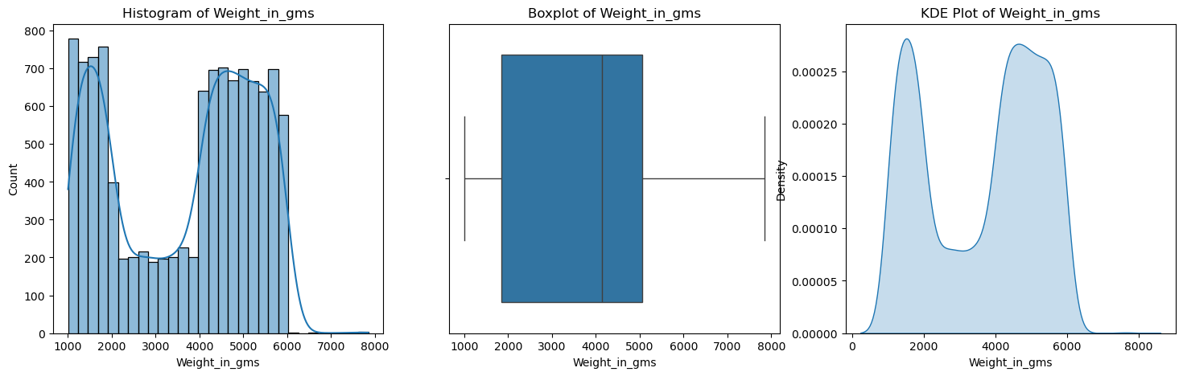
The histogram shows the frequency distribution of the weight of products in grams.
The presence of two peaks (bimodal distribution) indicates that there are two distinct groups of product weights.
The data has a bimodal distribution, meaning there are two clusters of product weights—one around 1,000-2,000 g and another around 4,000-6,000 g.
The boxplot shows the spread, median, and outliers of the weight variable.
The whiskers extend to show the range of the data, excluding extreme outliers.
The median (bold line inside the box) appears to be slightly skewed towards the upper quartile.
The weight distribution has a wide range, with some potential outliers at the lower and upper ends.
Two distinct groups of product weights, indicating that the e-commerce platform may be dealing with two different categories of products (e.g., lightweight and heavyweight items).

Slide 23
Why select as Random Forest is best model?
Low FN and High TP → Reduces Type II Errors, meaning fewer important cases are missed.
Good TN to FP ratio → Minimizes unnecessary false alarms.
Balanced Performance → Works well across both classes.
Handles non-linearity better.
Less prone to overfitting than a single Decision Tree.
Works well with large datasets and multiple features.
Best overall performance, handles complex data well, avoids overfitting with tuning

Slide 24
Cross validation of the model Hyperparameter Tuning for Random Forest (Best Model)
Random Forest has the highest accuracy (68.68%), making it the best performer in classification.
It also achieves the highest ROC-AUC score (74.57%), meaning it distinguishes between classes well.
Precision (86.93%) is the best among models, meaning fewer false positives.
Cross-Validation Accuracy for Random Forest = 60%
This is lower than the test set accuracy (68.68%), concludes some overfitting.
Cross-validation accuracy (60%) is significantly lower than test accuracy (68.68%), indicating potential overfitting.
To improve generalization, perform hyperparameter tuning. And saved as best model as joblib

Slide 25
CONCLUSION
This project successfully applied Machine Learning (ML) techniques to analyze E-Commerce customer behavior and predict transaction outcomes based on various customer attributes. The study involved Exploratory Data Analysis (EDA), Feature Engineering, Model Selection, Hyperparameter Tuning, and Performance Evaluation.
The Random Forest classifier emerged as the best-performing model with the highest ROC-AUC score (0.75) and balanced precision-recall metrics. The model showed good generalization, as confirmed by cross-validation accuracy (0.60), ensuring reliable predictions on unseen data.
Additionally, the study highlighted the importance of feature scaling, feature selection, and hyperparameter tuning in improving model performance.
Thus, the project successfully demonstrated how machine learning can enhance decision-making in e-commerce by predicting customer purchasing behavior, optimizing business strategies, and improving customer engagement.

Slide 26
Future Scope of the Project
1️⃣ Advanced Machine Learning Models
Implement XGBoost, LightGBM, or CatBoost to further optimize performance. And Explore Neural Networks and Deep Learning for more complex customer behavior analysis.
2️⃣ Real-Time Prediction System
Deploy the trained model in a real-time system for instant decision-making in e-commerce transactions. Use streaming data processing (e.g., Apache Kafka, AWS Kinesis) for real-time customer analytics.
3️⃣ Feature Engineering & Data Enrichment
Incorporate additional customer features like browsing history, product reviews, and clickstream data.Use external datasets (e.g., market trends, economic factors) to enhance prediction accuracy.
4️⃣ Fraud Detection & Anomaly Detection
Extend the model to detect fraudulent transactions using anomaly detection techniques. And Implement unsupervised learning (e.g., Isolation Forest, Autoencoders) for identifying suspicious transactions.
5️⃣ Personalized Customer Experience
Use customer segmentation & recommendation systems for personalized marketing strategies. And
Integrate NLP-based sentiment analysis to analyze customer feedback and improve service.

Slide 27
Thank You!

